Slide 1
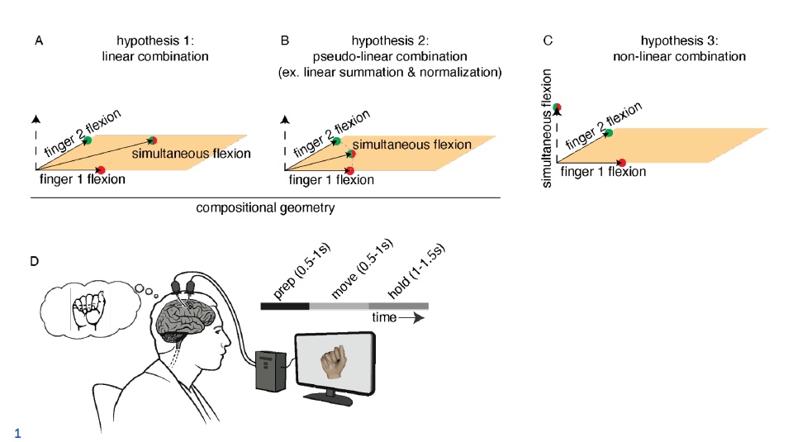
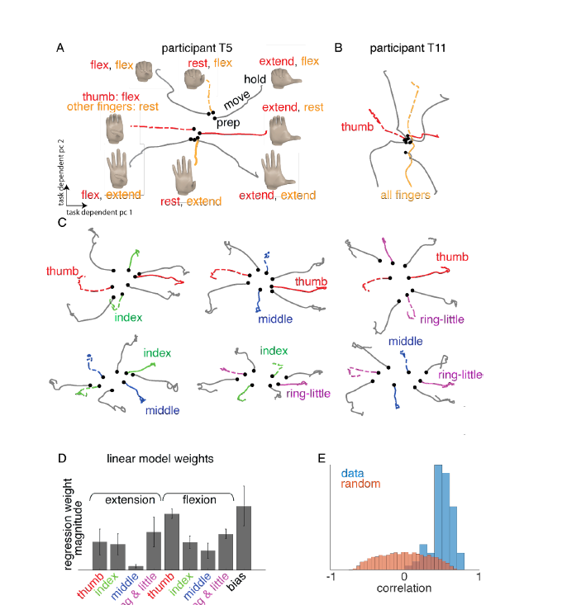
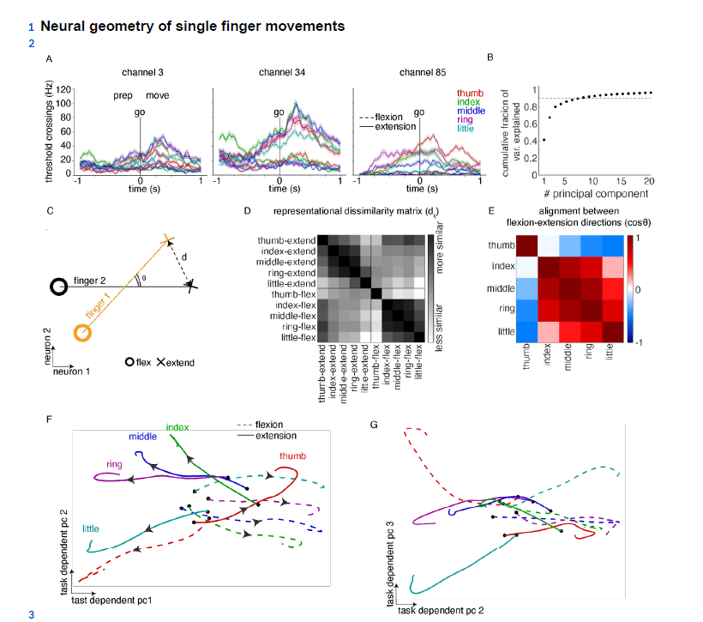
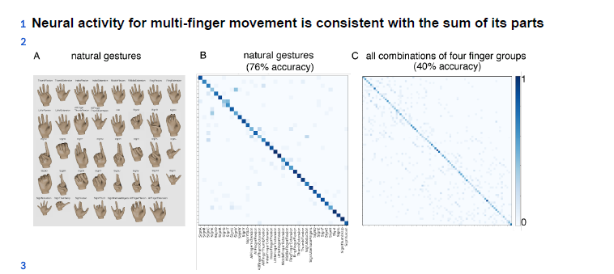
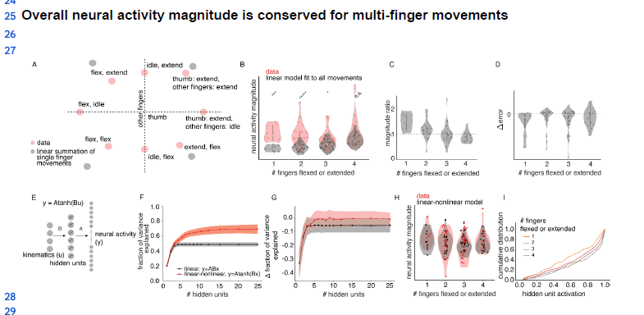
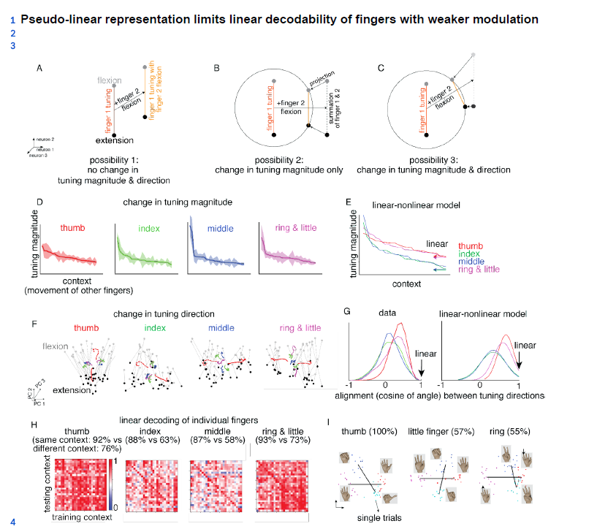
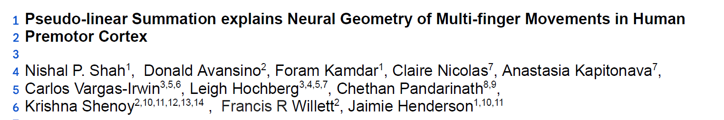
Related-work
Notes:
Pseudo-linear Summation explains Neural Geometry of Multi-finger Movements in Human Premotor Cortex

Slide 2
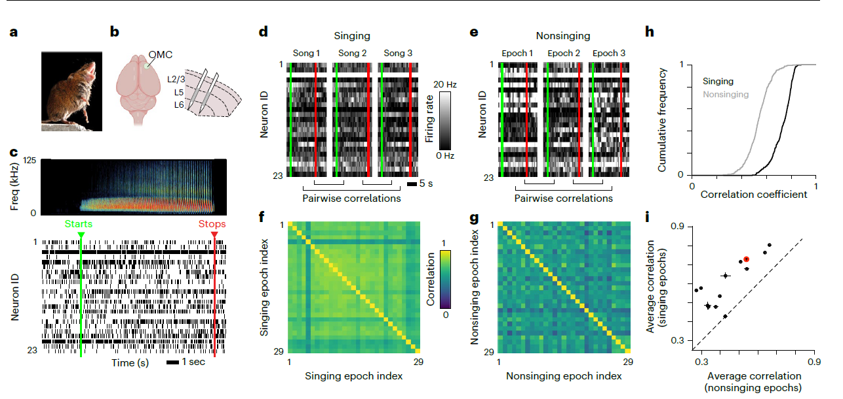
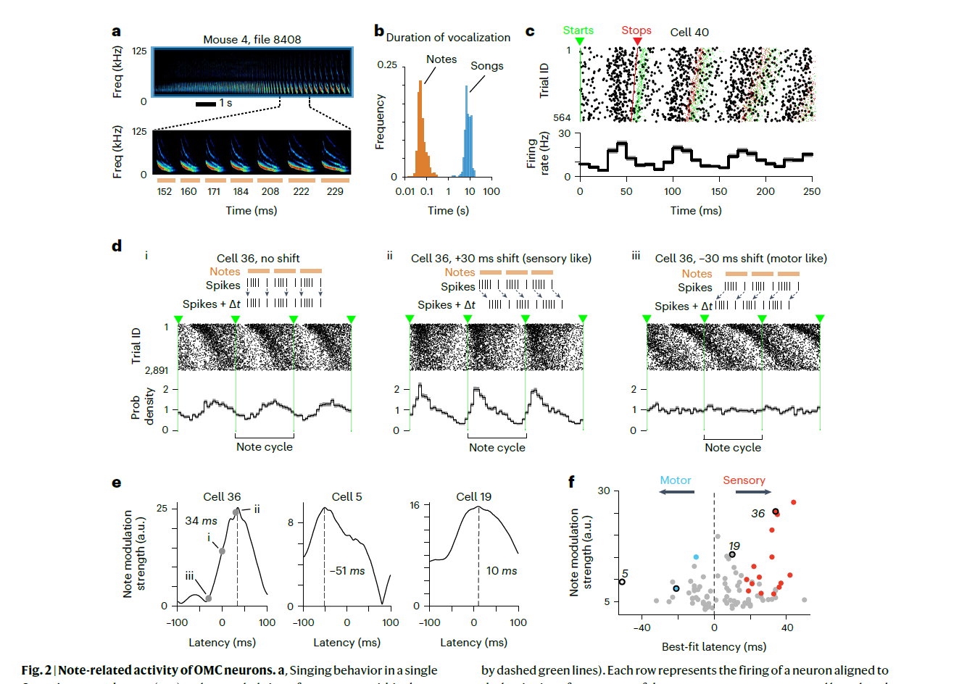
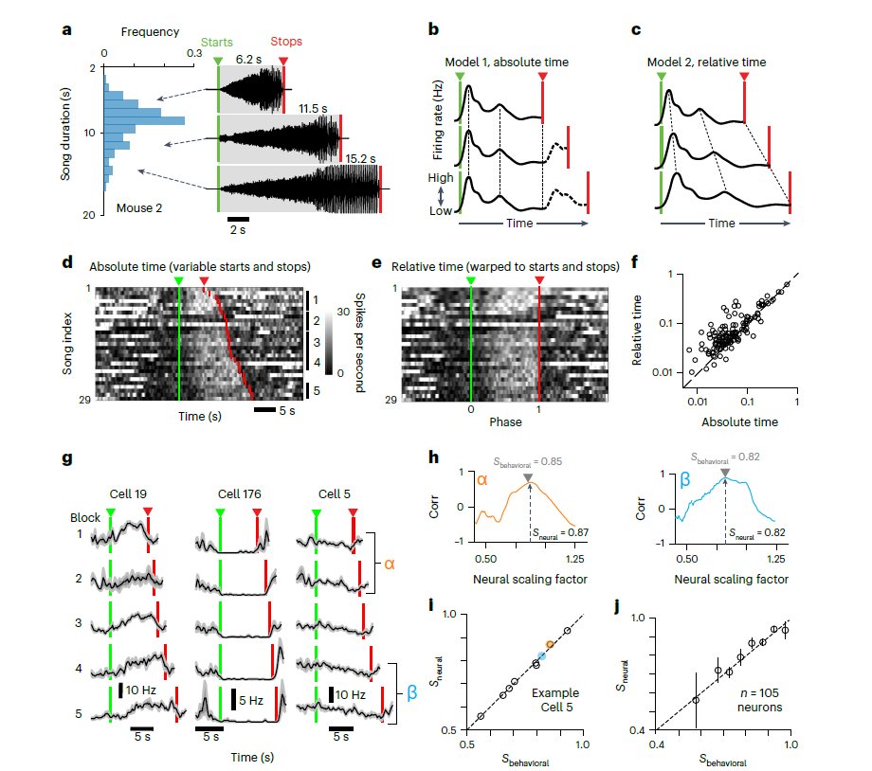
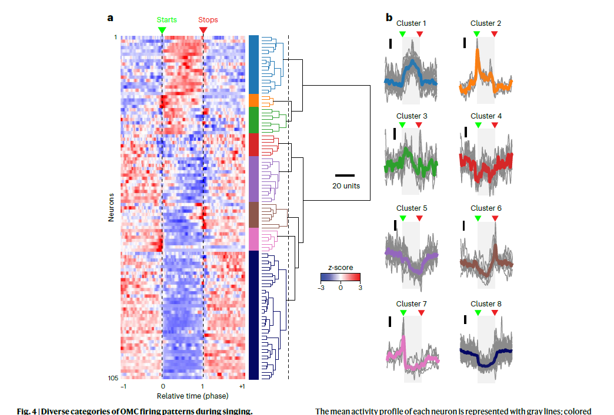
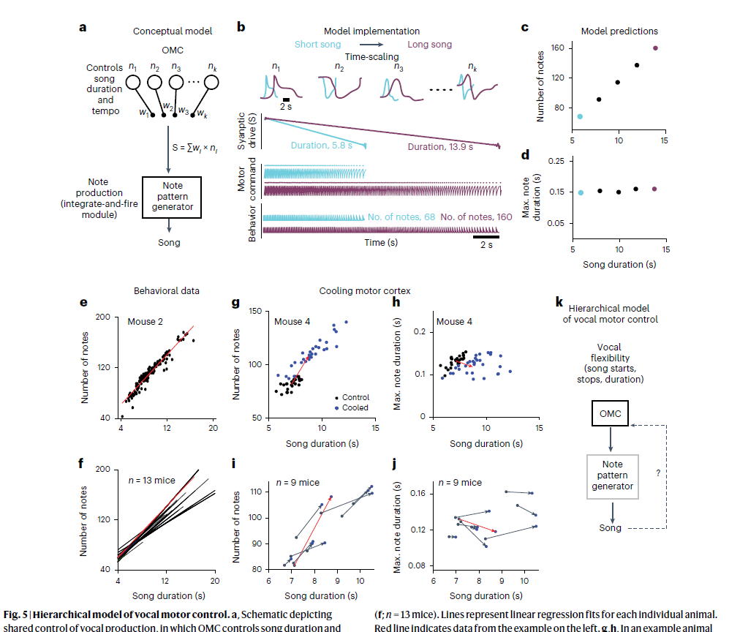
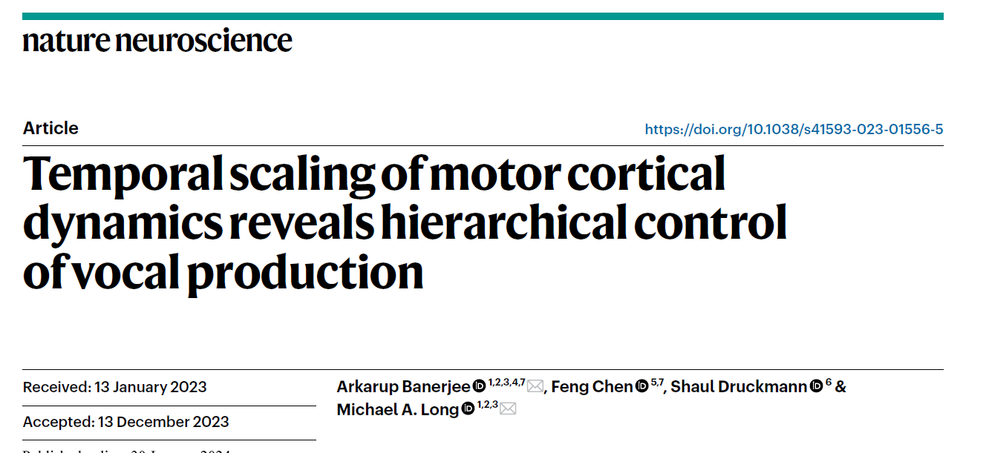
Related-work
Notes:
Temporal scaling of motor cortical
dynamics reveals hierarchical control
of vocal production

Slide 3
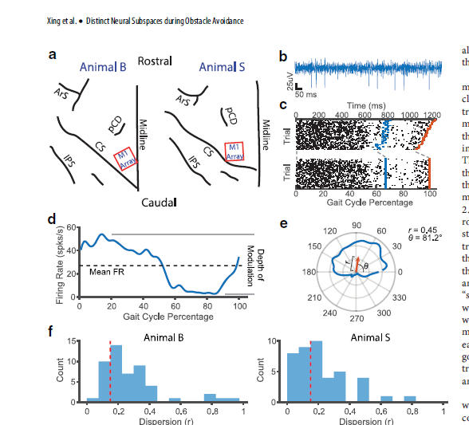
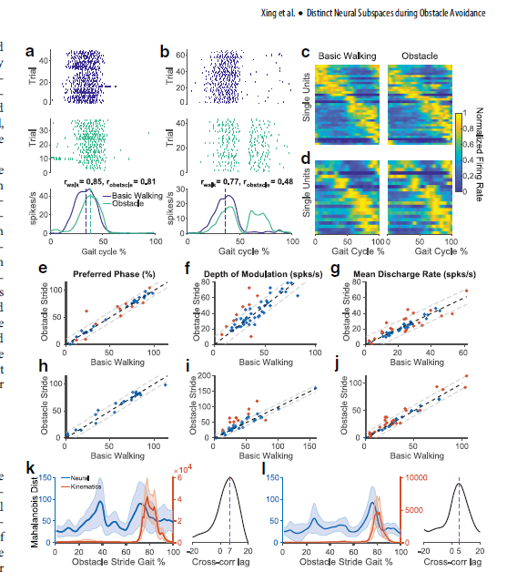
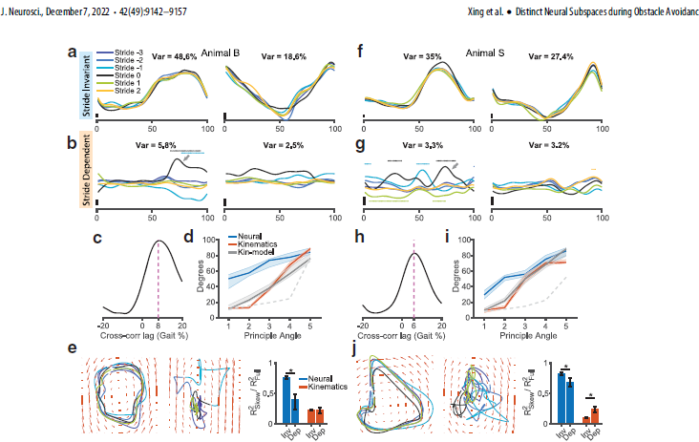
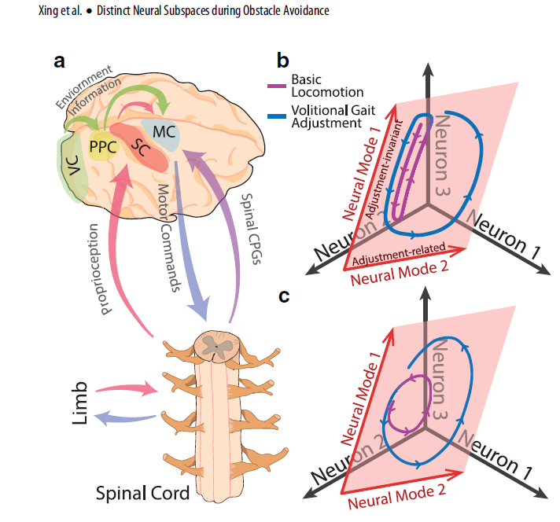
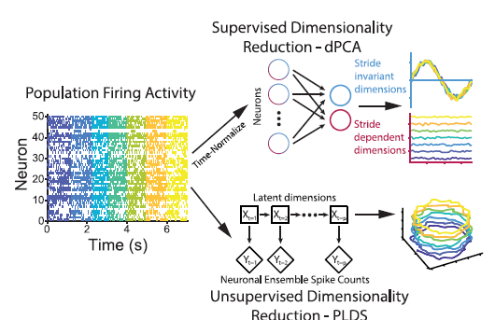
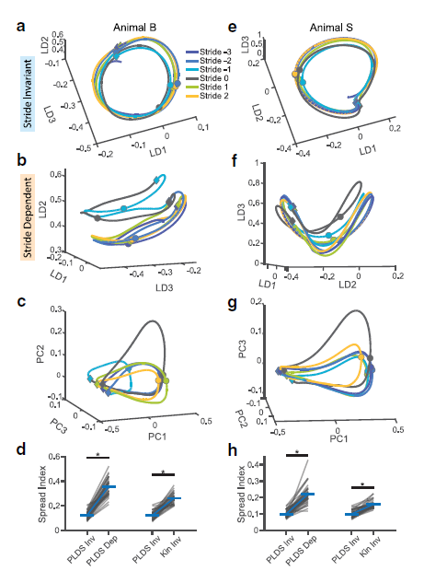
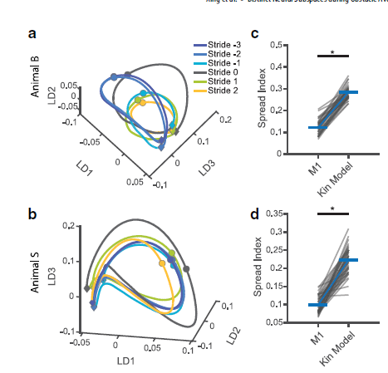
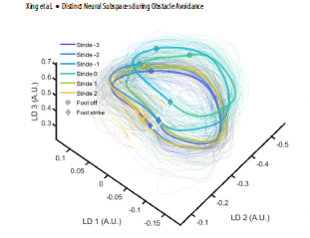
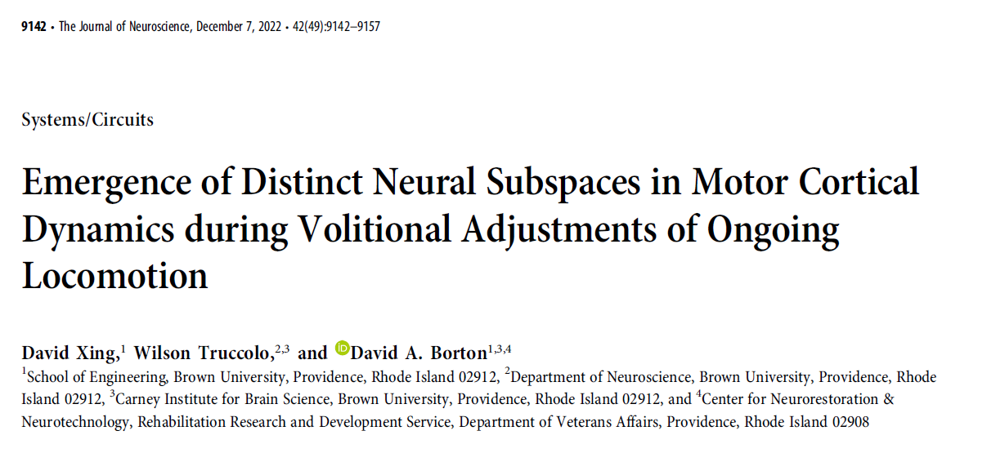
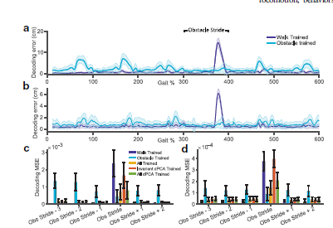
Related-work
Notes:
Emergence of Distinct Neural Subspaces in Motor Cortical Dynamics during Volitional Adjustments of Ongoing Locomotion

Slide 4
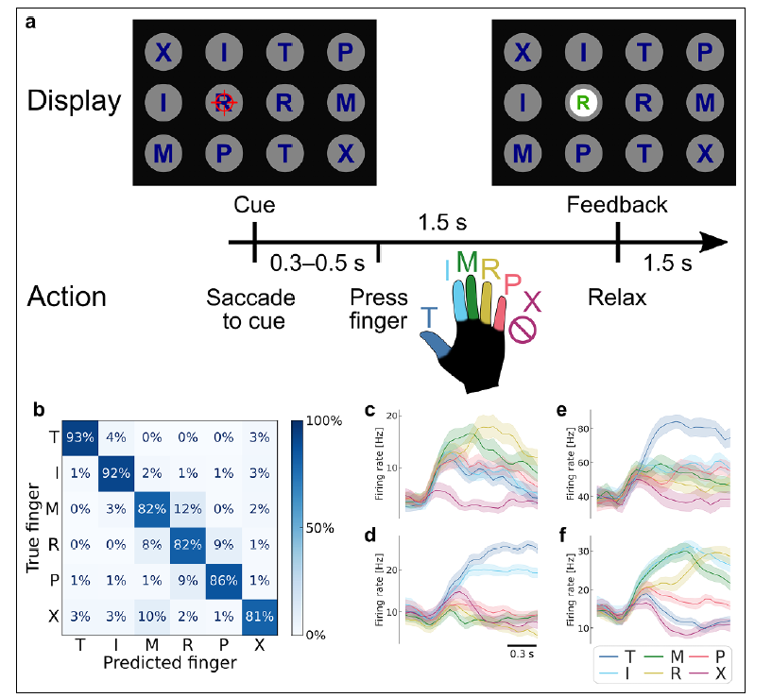
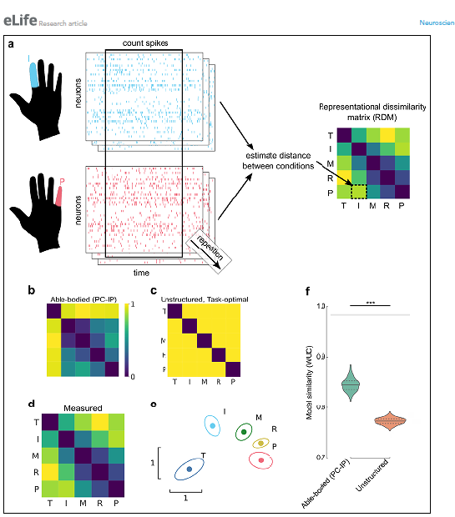
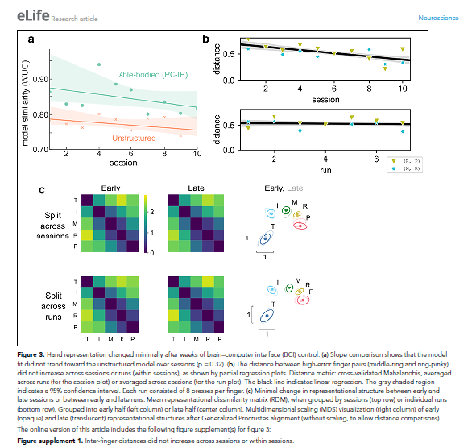
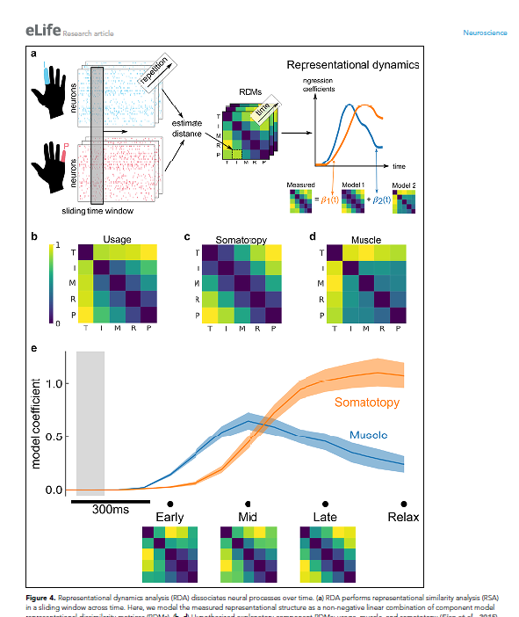
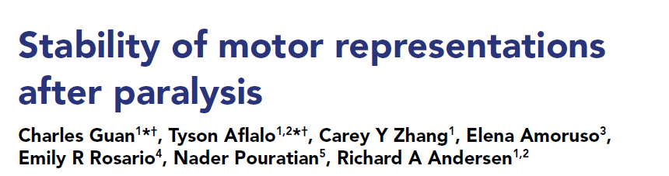
Related-work
Notes:
Stability of motor representations
after paralysis

Slide 5
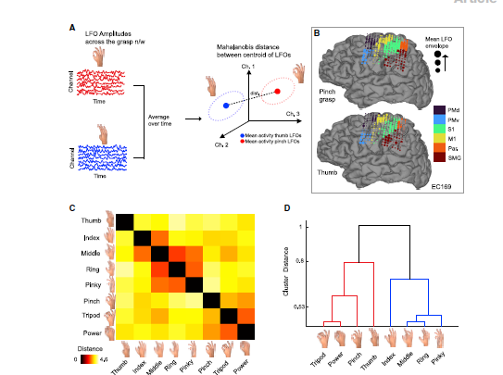
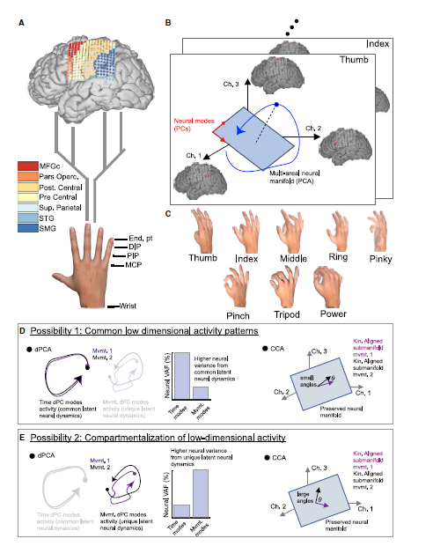
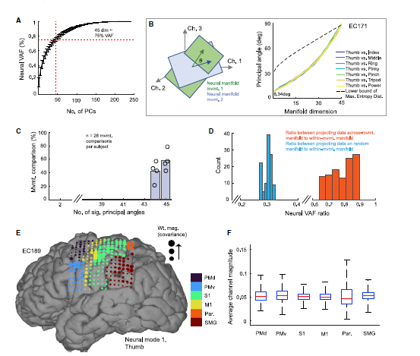
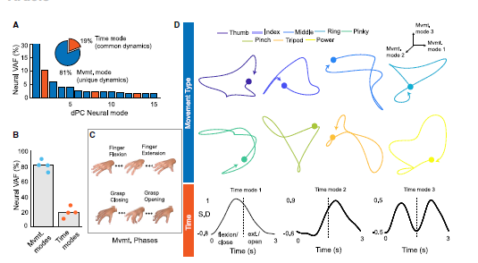
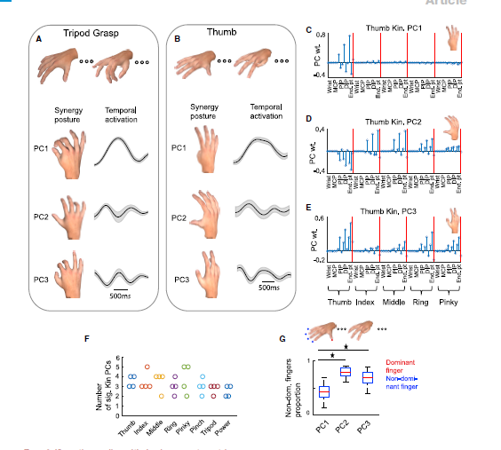
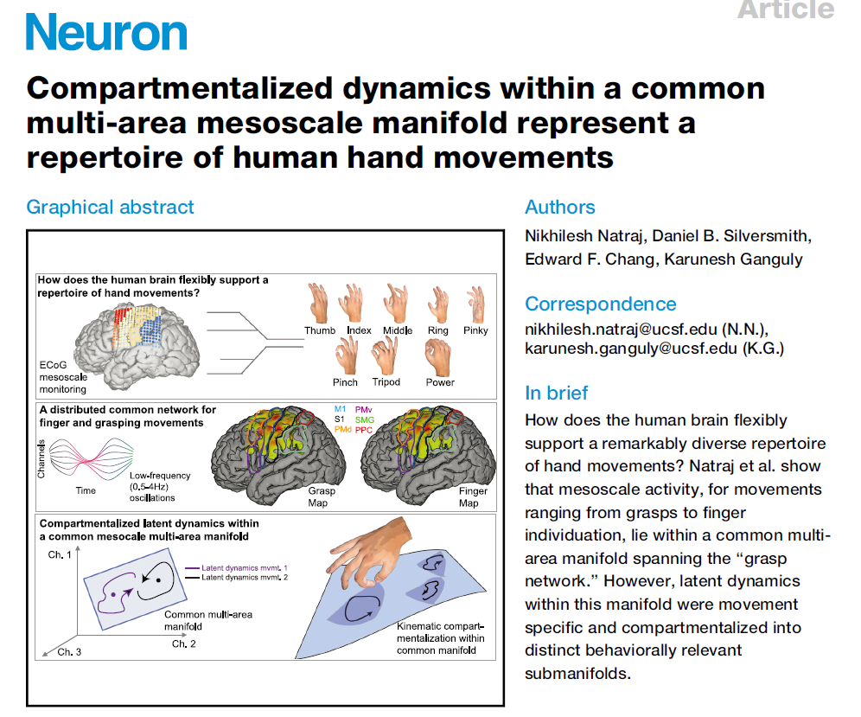
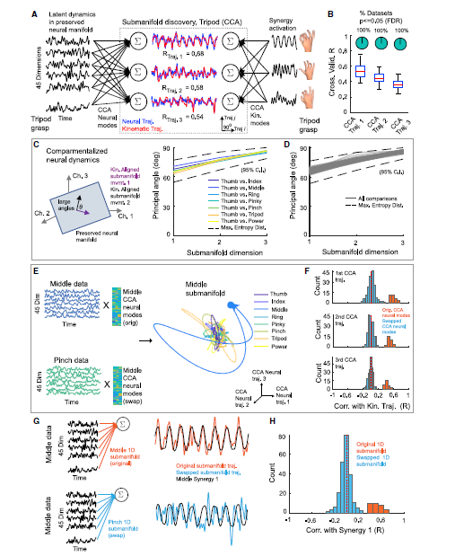
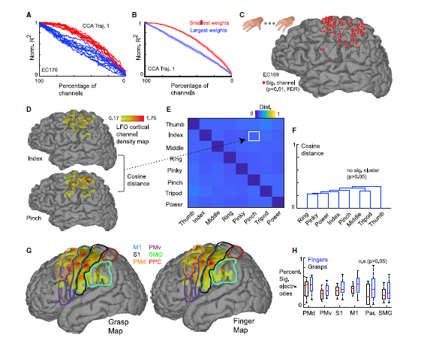
Related-work
Notes:
Compartmentalized dynamics within a common multi-area mesoscale manifold represent a repertoire of human hand movements

Slide 6
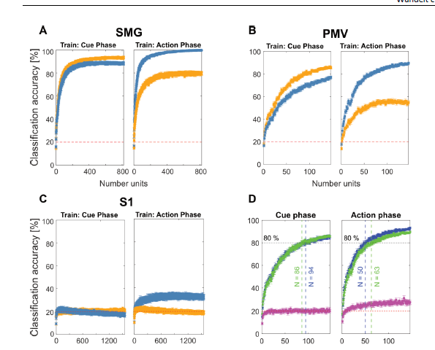
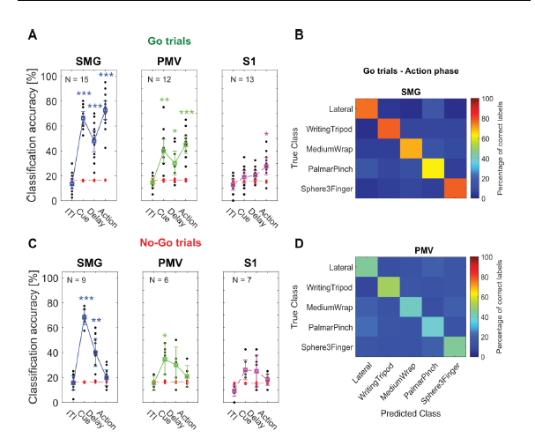
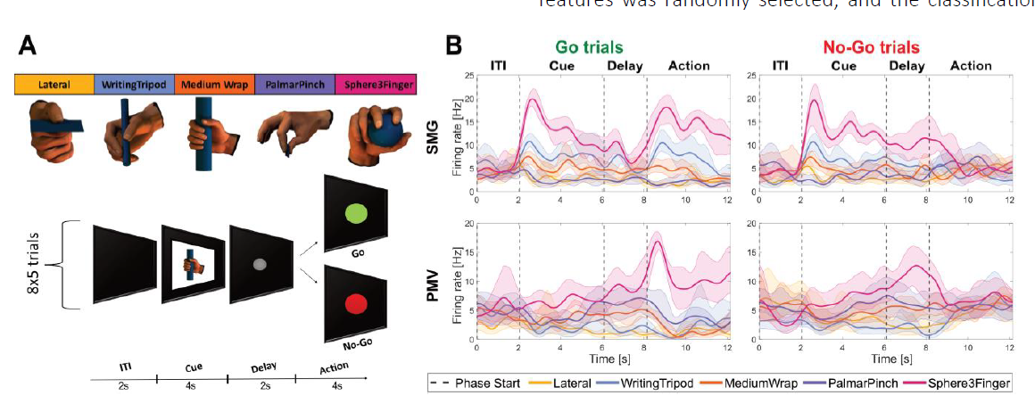
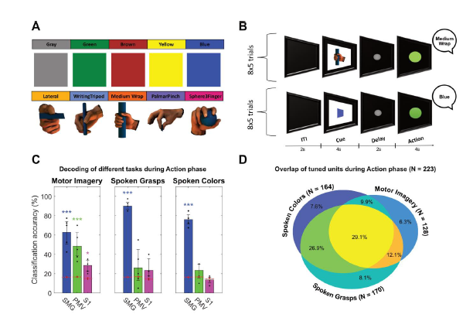
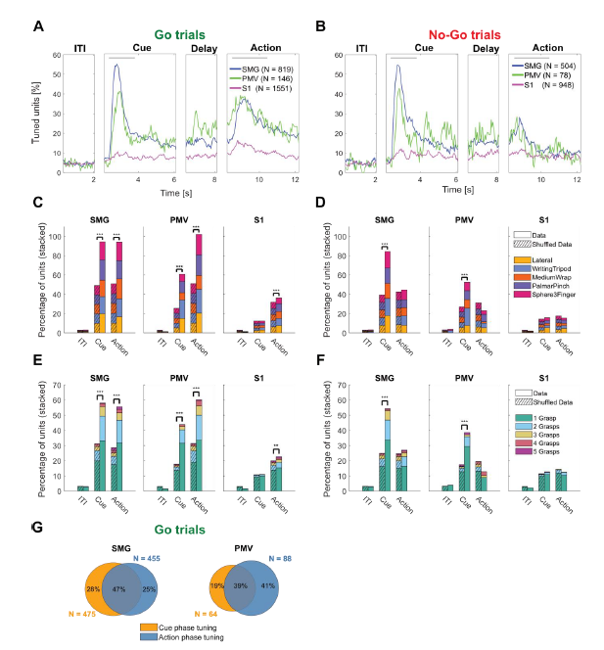
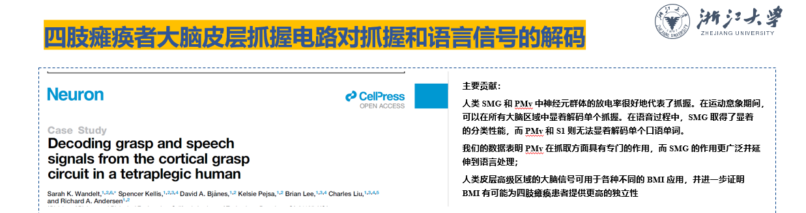
Related-work
Notes:
Decoding grasp and speech signals from the cortical grasp circuit in a tetralegic human

Slide 7
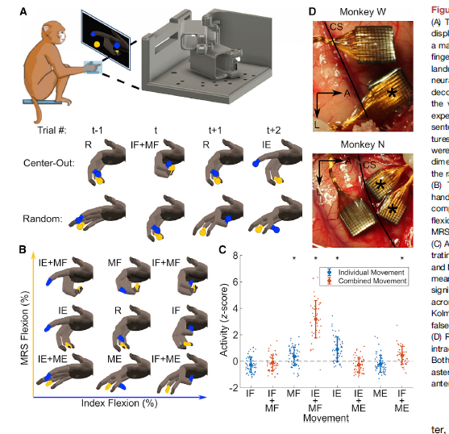
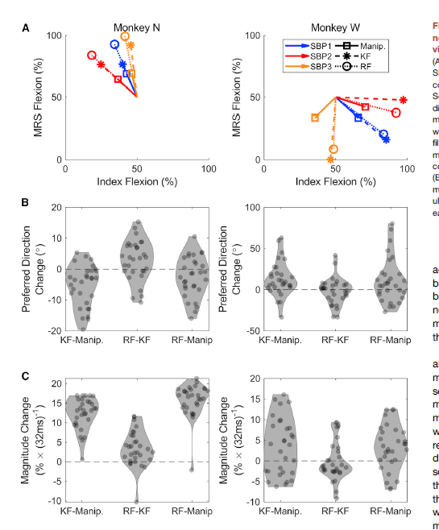
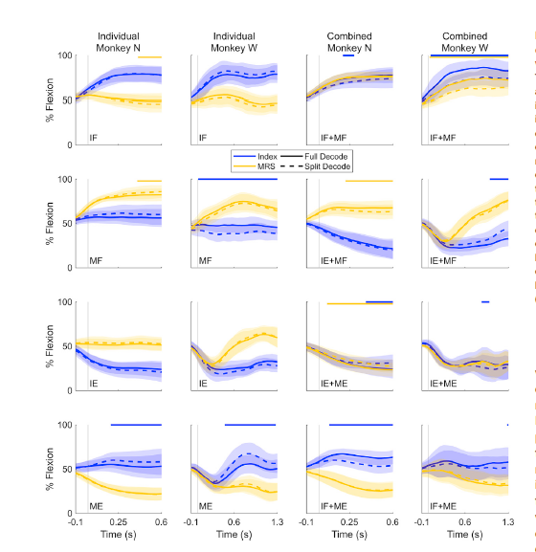
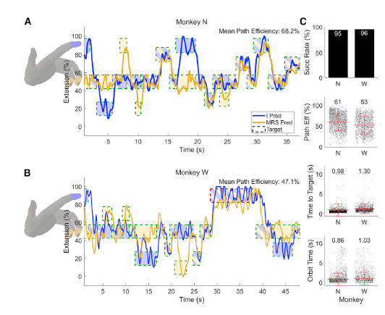
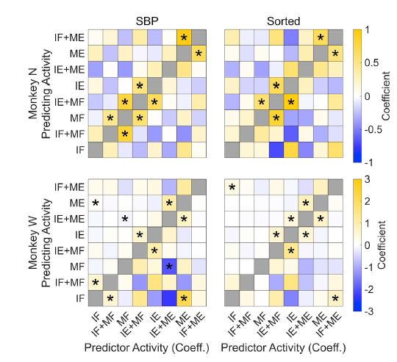
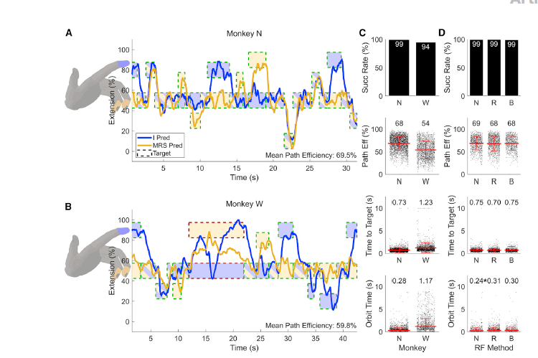
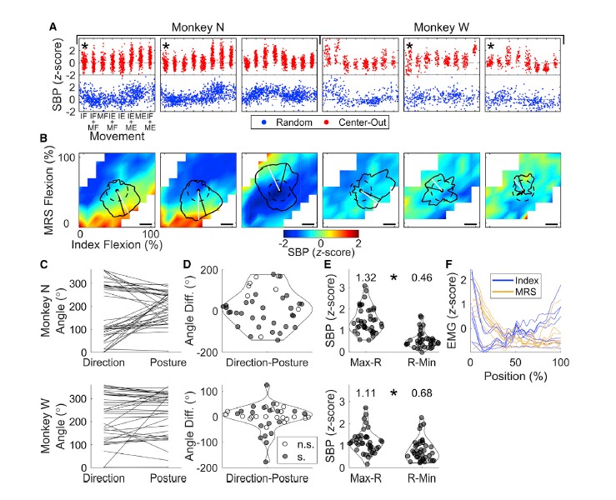
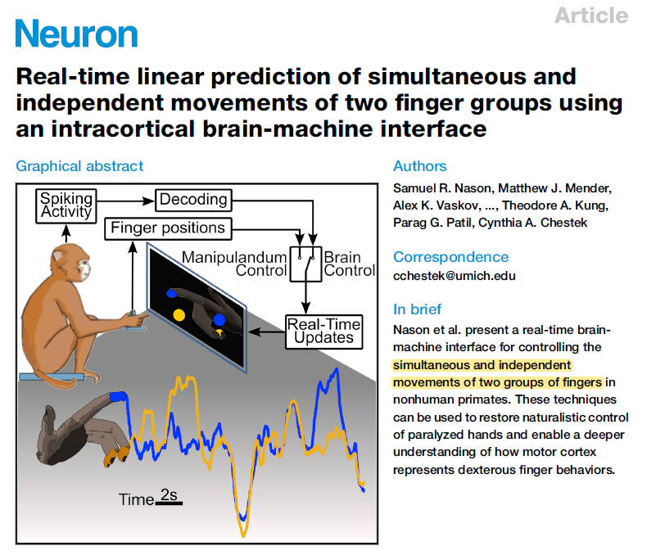
Related-work
Notes:
Real-time linear prediction of simultaneous and independent movements of two finger groups using an intracortical brain-machine interface

Slide 8







Related-work
Notes:
Neural basis for hand muscle synergies in the primate

Slide 9

Related-work
Notes:
Postural Representations of the Hand in the Primate
Sensorimotor Cortex

Slide 10







Related-work
Notes:
Geometry of sequence working memory in macaque

Slide 11









Related-work
Notes:
Long-term stability of cortical population dynamics underlying consistent behavior

Slide 12









Related-work
Notes:
Sequential and efficient neural-population coding of complex task information

Slide 13









Notes:
Neural Trajectories in the Supplementary Motor Area and Motor Cortex Exhibit Distinct Geometries Compatible with Different Classes of Computation

Slide 14









Notes:
Motor Cortex Embeds Muscle-like Commands in an
Untangled Population Response

Slide 15










Notes:
Motor cortex activity across movement speeds is predicted by network-level strategies for generating muscle activity

Slide 16




Related-work
Notes:
WalkTheDog~

Slide 17









Related-work
Notes:
DeepPhase: Periodic Autoencoders for Learning Motion Phase Manifolds

Slide 18





Notes:
A virtual rodent predicts the structure of neural activity across behaviors

Slide 19










Notes:
Decoding arm speed during reaching

Slide 20














Notes:
Mirror Neuron Populations Represent Sequences of Behavioral Epochs During Both Execution and Observation

Slide 21













Notes:
Multiplicative joint coding in preparatory activity for reaching sequence in macaque motor cortex

Slide 22







Notes:
Multiplicative mixing of object identity and image attributes in single inferior temporal neurons

